Slide 1
Clinical Usability
Dr Marcus Baw
Jon Hoeksma
20th September 2016

Slide 2
Section 1
What it’s like to use a system that isn’t very Usable?
*what you are about to see is from real NHS systems.
Names have been changed to protect the guilty.

Slide 3
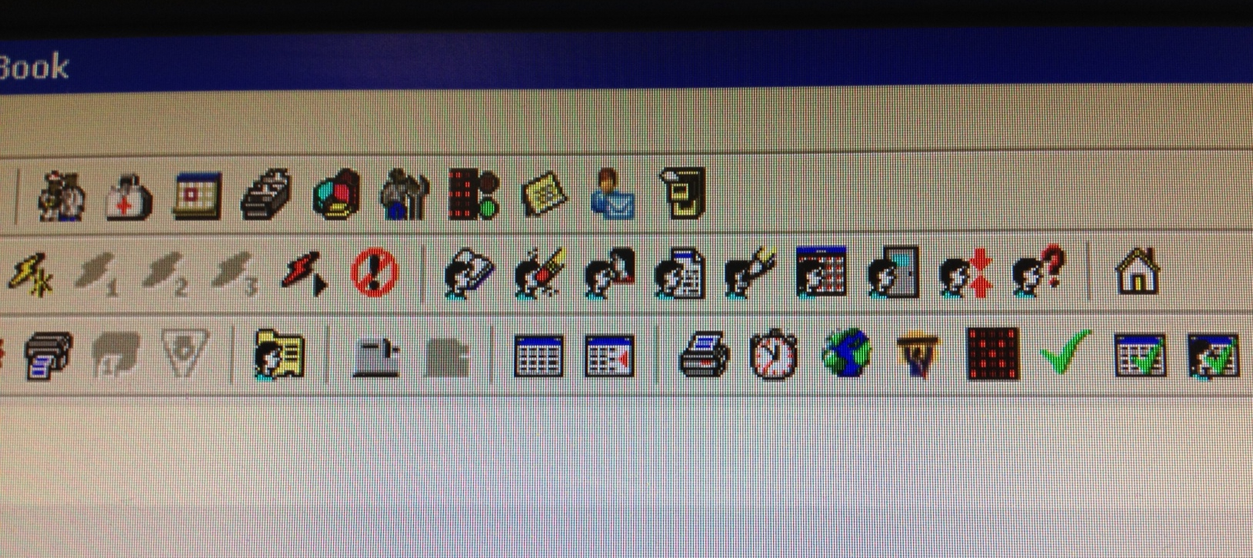
It takes longer to learn to use.
Some clinicians never achieve proficiency

Slide 4
Data quality is adversely affected, making nonsense out of the patients’ record, and of local and national data reuse for any purpose
Notes:
This is one of the most commonly used Read2/CTV3 codes. It’s used when systems don’t help the user find the right code for that interaction

Slide 5
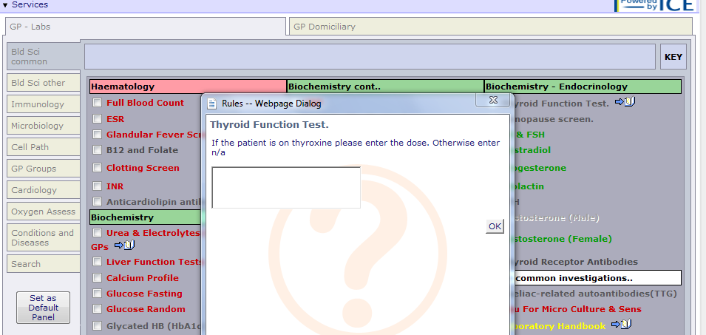
User interactions take longer.
Imagine the effect this has on each patient’s waiting time in A&E.

Slide 6
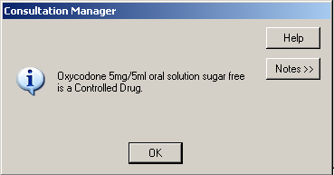
Users make mistakes, with potentially disastrous results

Slide 7
People find workarounds

Slide 8
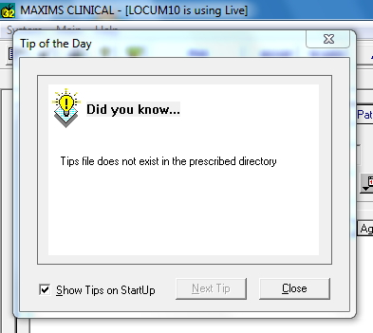
Sometimes it’s just annoying

Slide 9
The Importance of being Usable
“If it’s easier to do the right thing than the wrong thing, people will do the right thing” — Usability improves compliance with clinical coding, creates better and more reusable records, and increases safety.
Clinician time is too expensive to waste — It is one of the most expensive resources the NHS purchases. Using it wisely is the only way to match clinical demand with supply.
The recent Wachter review of NHS IT recommended User Centred Design (usability) be a key factor in the development of the NHS IT.
Empirically to drive adoption — digital devices only became commonplace since the advent of highly usable operating systems, features and form factors.

Slide 10
Section 2
The problem of measuring Usability

Slide 11
Usability is an abstract concept, meaning different things to different people
Inherently usability is also quite subjective
Objective measures are available, but they’re not perfect
Total usability is a compound measure, affected by lots of things:
hardware speed and platform
availability and quality of support
network speed and latency
multiple systems need for many different logins
interoperability and integration

Slide 12
System Usability Score
Score the following 10 items from Strongly Agree to Strongly disagree:
I think that I would like to use this system frequently.
I found the system unnecessarily complex.
I thought the system was easy to use.
I think that I would need the support of a technical person to be able to use this system.
I found the various functions in this system were well integrated.
I thought there was too much inconsistency in this system.
I would imagine that most people would learn to use this system very quickly.
I found the system very cumbersome to use.
I felt very confident using the system.
I needed to learn a lot of things before I could get going with this system.

Slide 13
Using the Systems Usability Scale (SUS)
+
Allows (a degree of) cross-industry comparison and benchmarking
Validated in the IT industry (other people use it)
−
It’s a bit vague

Slide 14
Clinical System Usability Score ‘cSUS’
An new ‘invented’ scale
Created by the CCIO and CIO networks at 2015 CCIO Summer School Newcastle (of Newcastle Declaration fame)
Draws heavily on SUS, with a similar scoring pattern
‘Clinically relevant’ questions:

Slide 15
cSUS Questions
In my opinion, the software reduces the risk of clinical error.
Effective support for this software is hard to access in a clinically-appropriate timescale.
In my opinion, the software improves the quality of clinical care I can provide.
The quality of the interaction/consultation with the patient is adversely affected by the use of this software.
Using the software gives me the key information I need on patient’s history, diagnosed conditions and current care and treatment plan.

Slide 16
2015/16 Questionnaire-based cSUS Survey
Type of Trust (Acute Foundation, CCG, etc), Trust Name
System Name
Email Address (we promised not to use this for anything except for updates about the survey)
The 10 SUS questions
The 5 cSUS questions
Free text feedback:
‘What do you like most about the system?’
‘What would you change about the system?’
Share links page - facebook, twitter, email

Slide 17
Selection of respondents
Basically, self selection - if you use clinical software (or say you do) then you can complete the survey
Respondents could also share via Twitter, Facebook, or email to colleagues
A huge majority of respondents used @nhs.net or *.nhs.uk email addresses, suggesting most were NHS employees
We aimed to avoid ‘typical’ health IT and informatics networks in promoting the survey.

Slide 18
Post-processing of SUS/cSUS
Removed null and spam responses
Exported to spreadsheet
Removed all email addresses from ‘working document’
Converted 0-4 scores for each SUS and cSUS item into a score for SUS (out of 100), score for cSUS (out of 50), and a Total Usability Score (out of 150)
Views of grouped responses by trust, system, etc
Basic statistical analysis to ascertain mean, SD, and confidence limits for each system
Notes:
Basically to reinforce the point that it’s not straightforward and needs to be done by experienced persons

Slide 19
Section 3
Results of the 2015-2016 Usability Survey

Slide 20
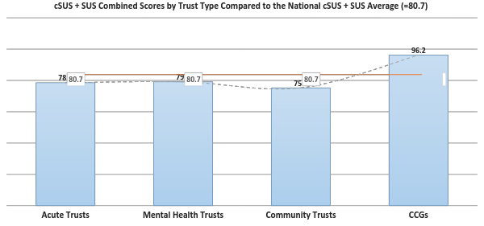

Slide 21
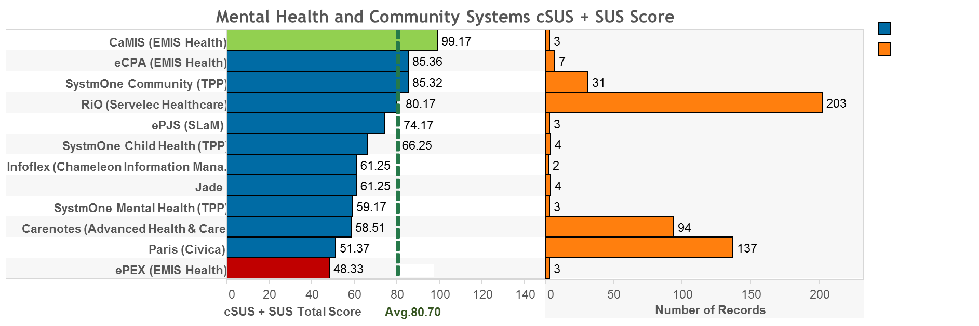

Slide 22
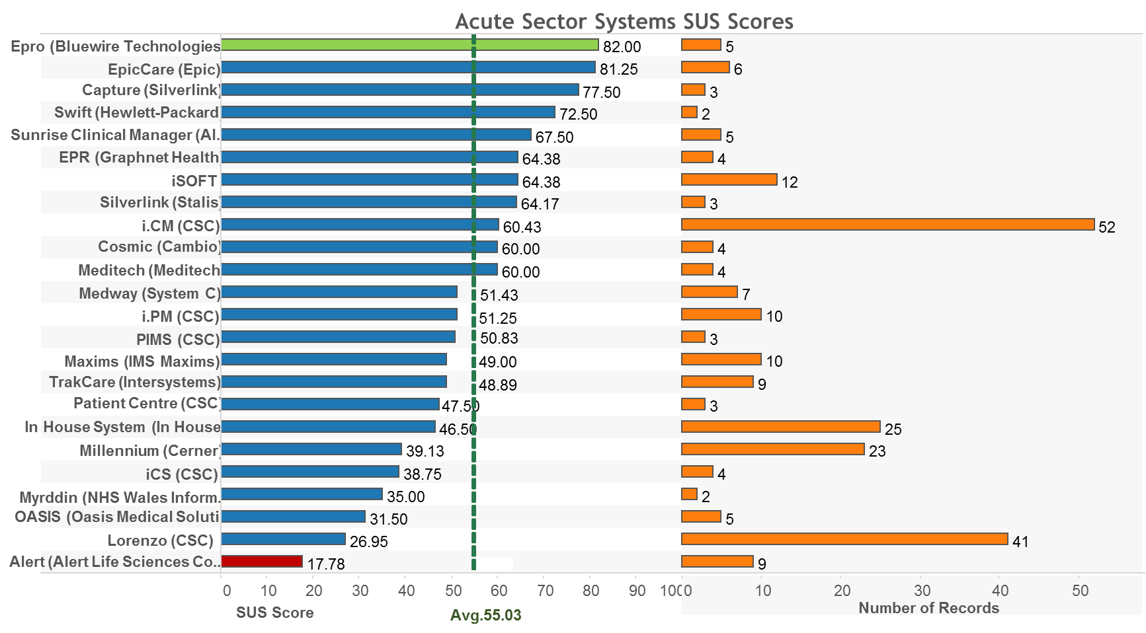

Slide 23
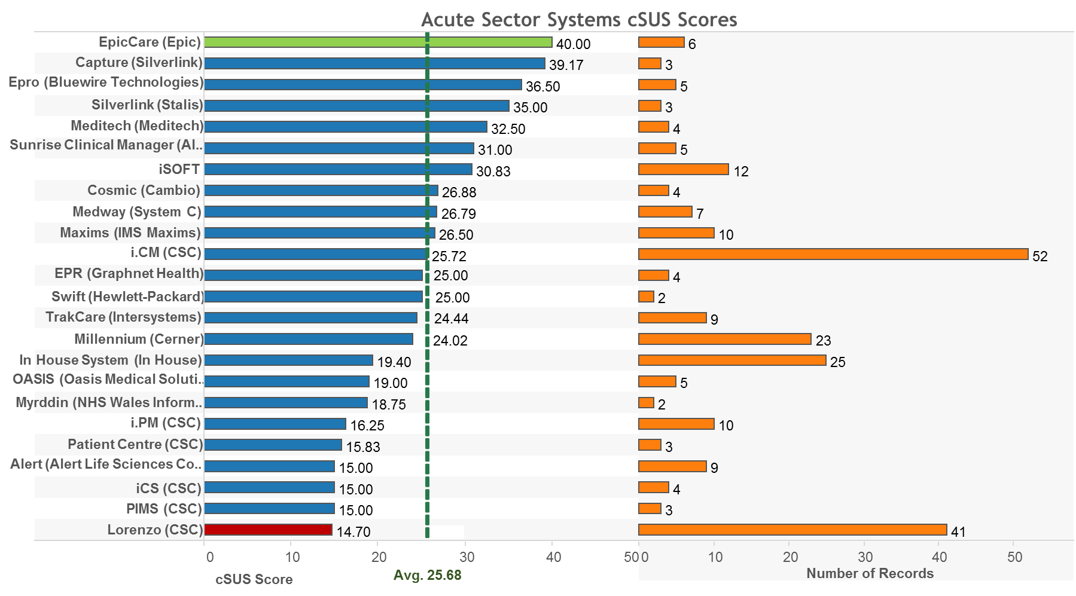

Slide 24
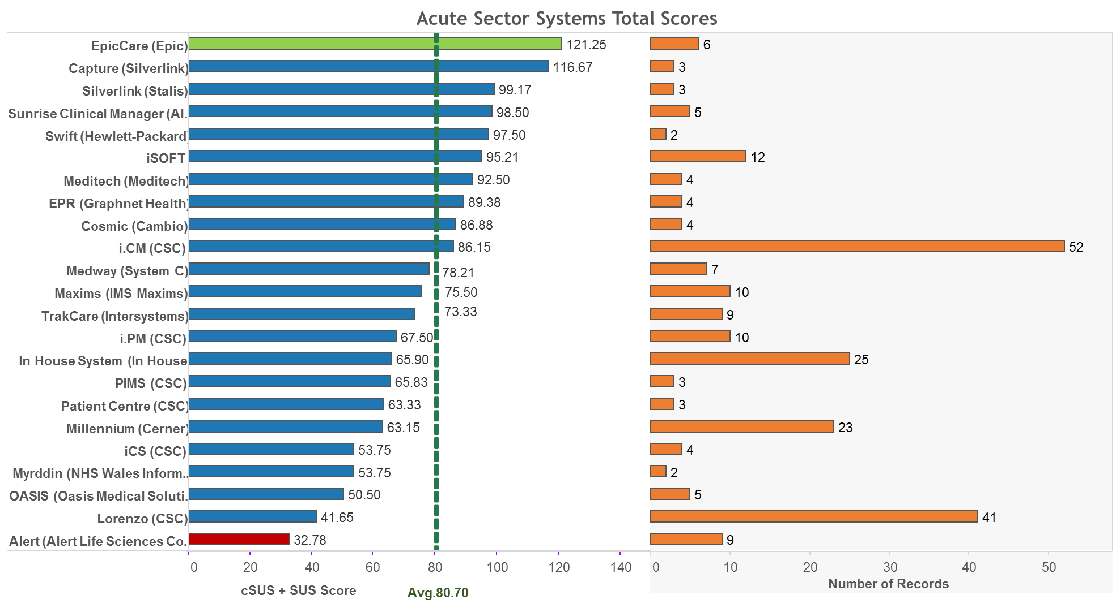

Slide 26
Take-home messages
Covered all areas of the NHS — mapped suppliers and systems using Digital Health Intelligence database, even finding some we missed eg. community dentistry
Health is not fundamentally worse on usability than other sectors — scores ‘OK’ - but is ‘OK’ good enough for the NHS?
Good response rate — 1500 individual responses from across the NHS, 50 thousand words of free text response
Rich detailed text responses — Were nuanced and showed in-depth understanding of differences between infrastructure, implementation and software.

Slide 27
Take-home messages
Compare The Software! — Respondents drew comparisons with other systems, without being prompted to. Comparisons were interesting.
People want to rate their systems and communicate both frustrations and things they’d like to see added.
Clinical governance and safety — IT systems are now inseparable from how healthcare is delivered. Clinicians must have the ability to flag up errors in a ‘responsible disclosure’ fashion.
Usability is a big issue for many users - Many NHS users had real frustrations with the software they use to treat patients and specific asks to improve

Slide 28
Limitations
This was a pilot – we urge people to treat data with caution
1500 responses were spread across ~80 systems. We need to achieve multiples of this response rate to enable statistically significant comparisons.
Some have very low levels of response – supressed <2
This means that the results don’t enable easy comparisons between trusts
What system? ‘The blue one’. Users sometimes struggled to ID what system they used – particularly where multiple releases of a system or older legacy products.

Slide 29
Section 4
What are the next steps for Usability?

Slide 30
Future cSUS ‘Platform’

Slide 31
Link to cSUS platform POC
csus-testing.herokuapp.com

Slide 32
The ‘cSUS Platform’ - ‘Compare the Software’ - general
Web application - allows much greater flexibility than a survey.
Users will sign up and leave reviews of systems - can review multiple systems, same system over time, add comments to previous reviews
It will support SUS, cSUS, star rating, free text, and maybe others?
It will enable NHS CCIOs and CIOs to carry out usability studies in their orgs and enable national anon benchmarking
Facility for bug reporting?
Supplier notification and right of reply
Links to user groups - create engaged, activated users

Slide 33
The ‘cSUS Platform’ - Data Quality
Clean simple, user experience or usability ratings
Will enable users to be validated as being NHS employees, and from a trust that we know uses that system.
Make it easier to select which system to review, since we know what systems are installed at which trusts (prevent ‘blank trust’ responses)
Much easier to filter and view data by Trust (or any other parameter) - helping suppliers to detect deployment/infrastructural issues
Richer data about respondents - user role, special interests, etc
Experiment with different kinds of usability assessment
Invite users to participate in more detailed usability testing?

Slide 34
Section 5
How NHS Digital can support improvements in usability

Slide 35
Wachter: Health IT Systems Must Embrace User-Centered Design
IT systems must be designed with the input of end- users, employing basic principles of user-centered design. Poorly designed and implemented systems can create opportunities for errors, and can result in frustrated healthcare professionals and patients.
“Another widely held criticism of today’s EHRs is their relative inattention to basic principles of user-centered design, particularly when judged against the electronic tools we have grown used to in the rest of our lives.”
“In The Digital Doctor, a case is described in which the lack of user-centered design, along with alert fatigue and overreliance on technology, resulted in a 39-fold overdose of a common antibiotic.”
“American Medical Association found that many doctors cited EHRs as a major source of burnout (44). The problem lies partly in poor design.”

Slide 36
Usability is essential not just a nice to have
Usability is key to adoption, safety and use of systems
Wachter says poor usability of clinical software linked to clinician burnout
cSUS represents two years of work on usability and is grounded in CCIO and Health CIO Networks - members using the tool to benchmark locally
A national service enables benchmarking against industry, sector, supplier and system average
DHI can credibly develop and deliver this at lower cost and much more rapidly than NHS Digital
NHS Digital don’t have in-house experience with usability scoring and testing - scoring own homework problem
An independent site may have better perceived impartiality and engagement

Slide 37
Proposal to give voice to end-user experience on usability
Commission Digital Health Intelligence to provide a three-year independent national service on the usability of of software in use across health and care. 2017-2020
To be carried out at sufficient scale to enable site-by-site comparisons of organisations using same products and different users
Tools to be developed based on cSUS that will enable local CCIOs and CIOs to undertake usability studies locally that benchmark against national scores.
Initial focus to be the 12 exemplar sites (Oxford has already used cSUS internally)
All results to be published (reviewers de-identified) and an NHS ranking of software usability published on an annual basis from 2017

