Slide 1
Clinical Usability
Dr Marcus Baw
Jon Hoeksma
20th September 2016

Slide 2
Section 1
What it’s like to use a system that isn’t very Usable?
*what you are about to see is from real NHS systems.
Names have been changed to protect the guilty.

Slide 3
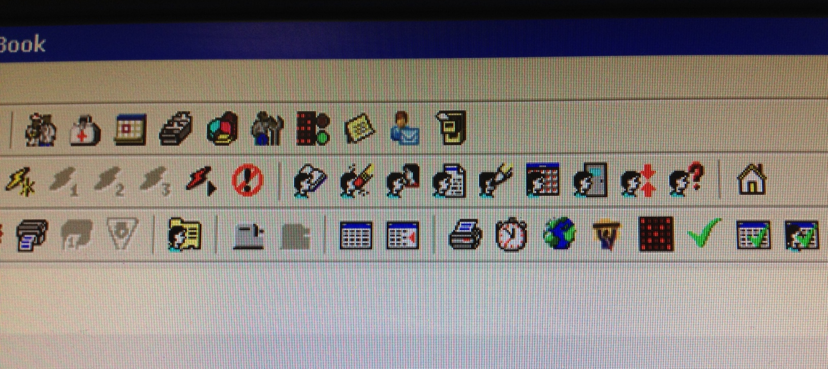
It takes longer to learn to use.
Some clinicians never achieve proficiency

Slide 4
Data quality is adversely affected, making nonsense out of the patients’ record, and of local and national data reuse for any purpose
Notes:
This is one of the most commonly used Read2/CTV3 codes. It’s used when systems don’t help the user find the right code for that interaction

Slide 5
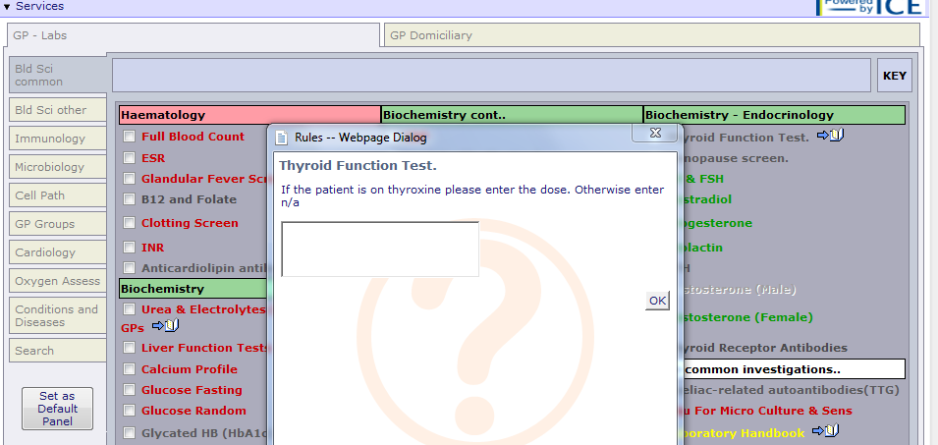
User interactions take longer.
Imagine the effect this has on each patient’s waiting time in A&E.

Slide 6
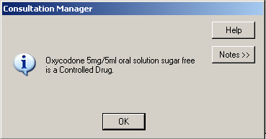
Users make mistakes, with potentially disastrous results

Slide 7
People find workarounds

Slide 8
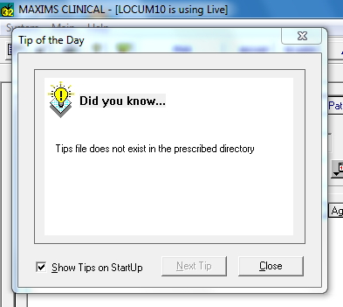
Sometimes it’s just annoying

Slide 9
The Importance of being Usable
“If it’s easier to do the right thing than the wrong thing, people will do the right thing” — Usability improves compliance with clinical coding, creates better and more reusable records, and increases safety.
Clinician time is too expensive to waste — It is one of the most expensive resources the NHS purchases. Using it wisely is the only way to match clinical demand with supply.
The recent Wachter review of NHS IT recommended User Centred Design (usability) be a key factor in the development of the NHS IT.
Empirically to drive adoption — digital devices only became commonplace since the advent of highly usable operating systems, features and form factors.

Slide 10
Section 2
The problem of measuring Usability

Slide 11
Usability is an abstract concept, meaning different things to different people
Inherently usability is also quite subjective
Objective measures are available, but they’re not perfect
Total usability is a compound measure, affected by lots of things:
hardware speed and platform
availability and quality of support
network speed and latency
multiple systems need for many different logins
interoperability and integration

Slide 12
System Usability Score
Score the following 10 items from Strongly Agree to Strongly disagree:
I think that I would like to use this system frequently.
I found the system unnecessarily complex.
I thought the system was easy to use.
I think that I would need the support of a technical person to be able to use this system.
I found the various functions in this system were well integrated.
I thought there was too much inconsistency in this system.
I would imagine that most people would learn to use this system very quickly.
I found the system very cumbersome to use.
I felt very confident using the system.
I needed to learn a lot of things before I could get going with this system.
Notes:
+
Allows (a degree of) cross-industry comparison and benchmarking
Validated in the IT industry (other people use it)
−
It’s a bit vague

Slide 13
cSUS Questions
In my opinion, the software reduces the risk of clinical error.
Effective support for this software is hard to access in a clinically-appropriate timescale.
In my opinion, the software improves the quality of clinical care I can provide.
The quality of the interaction/consultation with the patient is adversely affected by the use of this software.
Using the software gives me the key information I need on patient’s history, diagnosed conditions and current care and treatment plan.

Slide 14
Section 3
Results of the 2015-2016 Usability Survey

Slide 15
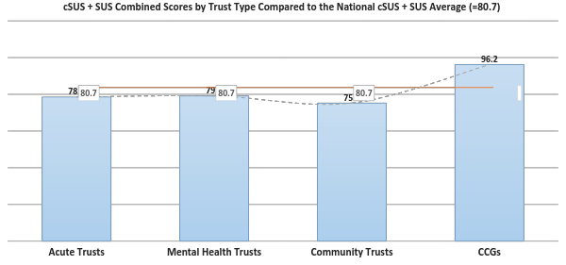

Slide 16
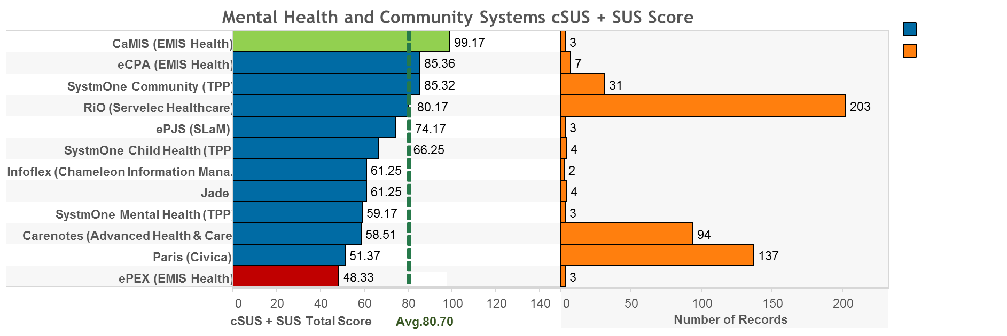

Slide 17
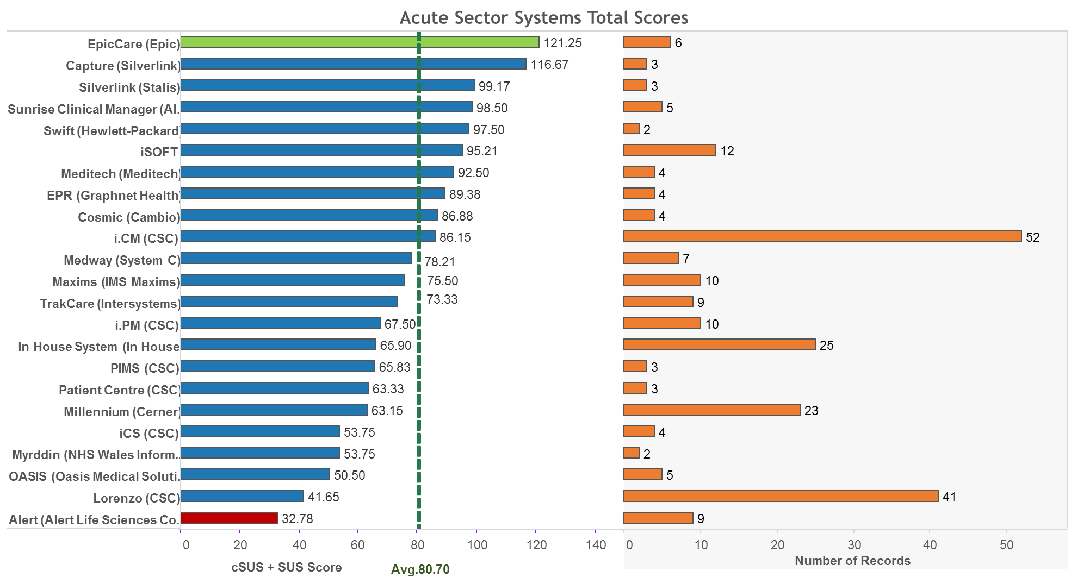

Slide 19
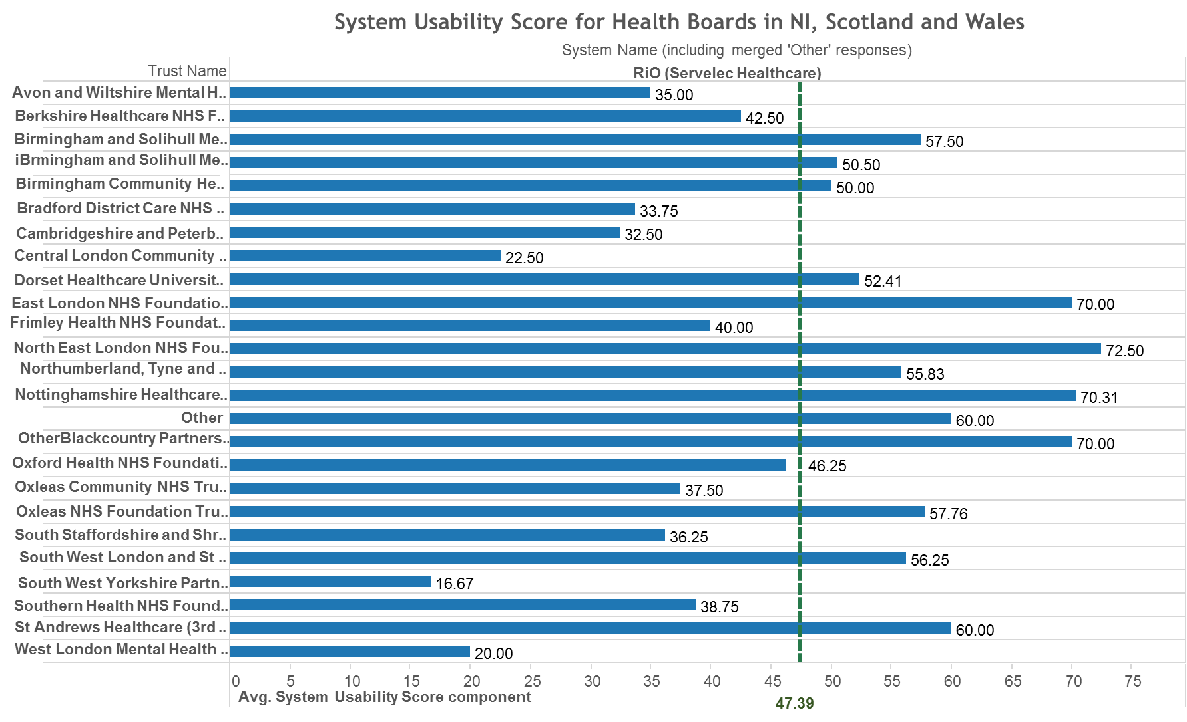

Slide 20
Take-home messages of the study
Comparative usability studies can work in NHS
There is statistically significant variation in usability scores — wide variations between different systems, and trusts using same systems — we need to get more data in order to draw actionable insights though
Compare The Software! — Respondents drew insightful comparisons with other systems, without necessarily being prompted.
People want to rate their systems and communicate both frustrations and things they’d like to see added.
Clinical governance and safety — IT systems are now inseparable from how healthcare is delivered. Clinicians need the ability to flag up software errors in a ‘responsible disclosure’ fashion.

Slide 21
Limitations
This was a pilot – we urge people to treat data with caution
1500 responses were spread across ~80 systems. We need to achieve multiples of this response rate to enable statistically significant comparisons.
Some have very low levels of response – supressed <2
This means that the results don’t enable easy comparisons between trusts
What system? ‘The blue one’. Users sometimes struggled to know what system they used – particularly where multiple releases of a system or older legacy products.

Slide 22
Proposal for a Usability Platform
Rich functional Web application - allowing much greater flexibility than a survey, with user customisation and better user experience.
Users will sign up and leave reviews of systems - can review multiple systems, same system over time, add comments to previous reviews
It will support SUS, cSUS, star rating, free text, and maybe other usability rating systems?
NHS CCIOs and CIOs can carry out usability studies in their organisations and enable national benchmarking
Supplier notification about reviews and right of reply
Link to user groups of each system - create engaged, activated users

Slide 23
Section 5
How NHS Digital can support improvements in usability

Slide 24
Benefits to NHS England and NHS Digital
Usability is key to adoption, safety and use of clinical systems.
Start with Exemplar sites (Oxford has already used cSUS internally).
Better visibility of usability will provide new levers and incentives that the centre can use to drive improvements from suppliers.
A rapid route to independence and credibility on usability.
cSUS is a tool designed by CCIO and Health CIO Networks, born of a grass-roots movement, and uniquely relevant to UK NHS healthcare.
Wachter says poor usability of clinical software linked to clinician burnout.
Better data on usability of systems can lead to better procurement decisions centrally and locally.
NHS gets to be a world leader in the real-time measurement of usability, user-driven design, and user feedback in systems.

Slide 25
Proposed timescale and delivery
Jan 2017 — Digital Health Intelligence begin to gear up national service
April 2017 — Dev and testing of new usability platform - launch
July 2017 — Announce first national ratings @ CCIO/CIO Summer School
Jan-Dec — Run quarterly analytics workshops -
Launch version of platform that will allow CCIOs and CIOs to undertake usability studies - Nov 2017
Y1 focus on the global exemplar sites
National investment will also enable
All results to be openly published (reviewers de-identified)
cSUS questions and ratings platform to be published under OS licence

Slide 26
Support needed from the centre
Three year resourcing.
National backing for the development and launch of an at-scale continuous review platform service
Very clear support and use of NHS brand and mailing lists
Support on high-level launch and partnerships with Royal Colleges and BCS Health
Annual usability statistics published openly.

Slide 27
Link to cSUS platform POC
csus-testing.herokuapp.com

